Slide 1

Lecture 8: MVC, Properties & Binding
WRPV301: Advanced Programming
Dr Simone Beets
Notes:
https://www.express.co.uk/sport/tennis/2047249/Alexander-Zverev-Madrid-Open-photo-court-warning?sfnsn=scwspwa
Express link on Madrid open
Clay hard to have electronic line calls, but introduced this year
Sabalenka
Zverev – ball out
Line changed?
Technology – line calls (bad), photo (good)
Unsportsmanlike behaviour
Rely on the systems we build
Not have all figured out

Slide 2
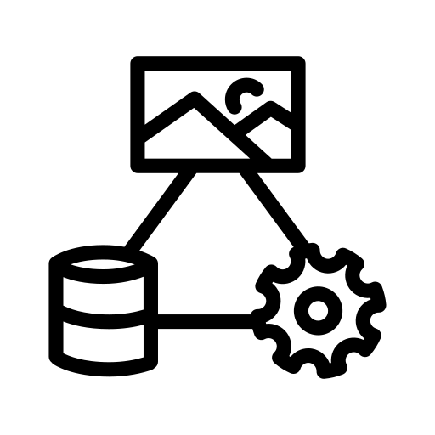
MVC

Slide 3
Typical UIs
MVC pattern
General properties & binding
Properties & binding in a UI
Using MVC in your code
MVC

Slide 4
Typical UI application
Displays data
As text, images, colours, slider positions, etc.
A user can manipulate the UI
By typing, clicking, dragging, etc.
Interacting with the UI generates an event
Event type depends on the type of UI control, e.g.,
for a button → clicked, gained/lost focus, mouse over
for a text field → gained/lost focus, pressed a key, mouse over
Interacting with the UI results in the data being changed
Data & UI are synched

Slide 5
Synching the data & UI (the manual way)
Have data that is displayed by the UI
To sync the data & UI
Need to display initial values for the UI
Need to attach events such at if UI changes, the data is updated
E.g., for a TextField, t, displaying age
Initially set t’s text to age
If the user presses enter or t loses focus
Get t’s text, convert text to age’s type
Then: validate the data & set age to data
If multiple controls refer to the same data value, need to update all together

Slide 6
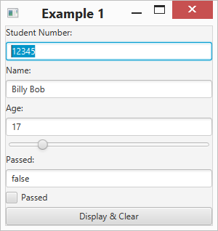
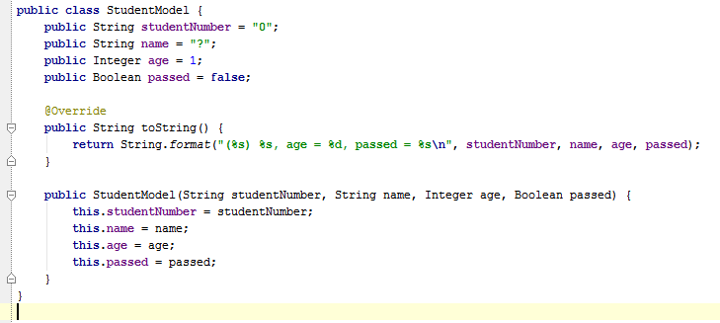
Synching the data & UI (the manual way)
See /Example01

Slide 7
Observer pattern
Problem:
Object A needs to know the state of another object, Object B
Object B can be changed by other objects, Object C, D, E, etc.
Question:
How can Object A by synched with Object B?
i.e., if Object B changes, then Object A must be updated
Answer:
One way is to have Object A poll Object B
BUT that is inefficient

Slide 8
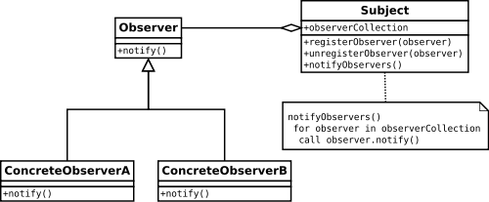
Observer pattern
Pattern:
Allows a subject to notify observers of changes to the subject’s state
State includes the data values & interesting events, e.g., a button clicked
http://en.wikipedia.org/wiki/Observer_pattern
Notes:
You did this in the practical assignment about Properties & Property Listeners

Slide 9

Who can explain the MVC pattern?

Slide 10


Model-View-Controller (MVC) pattern
Responsible for storing & retrieving data
Maintaining state
[Notifying observers of change in state]
Does not know about View per se
Problem: Synching data & the UI, low coupling
Model
polls &
modifies
Responsible for responding to user input
Manipulates Model in response to user input
Tells View how to render Model
notifies of
changes
Controller
notifies of
interaction
View
modifies
Interacts with user
Notifies of interactions
User
https://en.wikipedia.org/wiki/Model%E2%80%93view%E2%80%93controller

Slide 11
JavaFX & MVC
Model
Properties that are observable
Properties that may be bound together
E.g., the text property of a UI control is bound to a model’s integer property
Controller that responds to UI events & modifies UI/model
A property is a type of model
A binding is a type of controller
P
Controller
B
control
P
View
User

Slide 12
Binding
Property
A property has a value
A property is observable (i.e., implements the Observable interface)
If the value changes, can notify interested parties
Different types of properties
E.g., IntegerProperty, StringProperty, FloatProperty, Property<Object>, etc.
Linking the value of 1 property to another property (1-, 2-directional)
Can create a binding that calculates a value based on other properties bound to using the Fluent API
Has methods, such as add, concat, multiple, etc. that string together
http://docs.oracle.com/javafx/2/binding/jfxpub-binding.htm
https://docs.oracle.com/javase/8/javafx/api/javafx/beans/binding/Bindings.html

Slide 13
Types of bindings
Can bind a property to 1 (or more other properties)
E.g., A ⇦ B & C (A bound to B & C)
If B or C changes, then A changes too
1-Directional bindings (A ⇦ B)
A is bound to B
A gets its value from B
If B changes, A does too
A cannot be changed other than through B (read-only)
A
C
E
D

Slide 14
Types of bindings
Bi-directional (A ⬄ B)
A & B have the same value
Changing A changes B
Changing B changes A
May change either property (read-write)
B
F
A
C
E
D

Slide 15
Complex bindings
May create a 1-directional binding where the bound property’s value is calculated
Example:
Area ⇦ Width x Height
If Width or Height changes, Area changes
Message ⇦ “Area = ” + Area
If Area changes, Message changes
Since Area is bound to Width & Height
If Width or Height change, Area changes, then Message will change too
= “Area = 20”
= 5
= 20
W
Msg
Area
×
= 4
“Area = ” +
H

Slide 16
Complex bindings
May create a 1-directional binding where the bound property’s value is calculated
Example:
Biggest ⇦ if (A > B), then A else B
If A or B changes, Biggest is recalculated
These types of bindings may be done either manually or by using the Fluent API
See /Example02
= “Area = 20”
= 5
= 20
W
Msg
Area
×
= 4
“Area = ” +
H

Slide 17

Using properties with JavaFX
P
Student Model
P
Model
The data that will be viewed & manipulated
Has properties
P
P
B
View
The UI that is created
B
Controller
Controller
Bindings between the UI control properties & the model properties
Additional logic
See /Example03
B
P
P
B
P
P
P
P
User
View

Slide 18
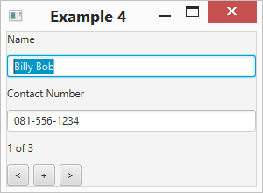
/Example04
Model = Contact info & Contacts
Each contact has properties that can be bound to
View = created in Example04.createScene
Controller
Initialises a list of contacts (model)
Sets up connections with View in Controller.connectToUI method
Manages logic
Current index property controls which contact is the current one
Location label listens to changes in the current index & updates the string, e.g., “X of Y”
Binds the text fields to the current contact’s properties
Prev/Next buttons unbind from previous contact, bind to next one
New button creates a new contact, adds to the list & sets it as current

Slide 19
Model
View
selected from
name
contact
number
bi-directional
binding
Contacts
change
triggers
rebinding
value of
bound to
(read-only)
current
contact
bound to
(read-only)
modifies
Controller
add new contact
modifies
(selects contact
from contacts)
current
index
current
size
set to last
update

Slide 20
Assignments
Assignment 3:
Due – this Friday!
Peer reviews – Tuesday
Assignment 4:
Will upload end of the week
Due – check schedule

Slide 21

Class exercise
You have 10 minutes…
Instructions:
In groups of 5 (add your names)
You can use any device that you have with you, but also don’t forget about chatting to each other too!
You can use any electronic source available
Use pen & paper & hand in
Questions:
What is the key difference between an Event Listener & an Observer?
Give 2 examples to explain the difference identified in Question 1.
From the self-study lecture on SOLID principles, how can the way you write source code comments serve as a warning sign that your class might be violating the Single Responsibility Principle?

